Slide 1
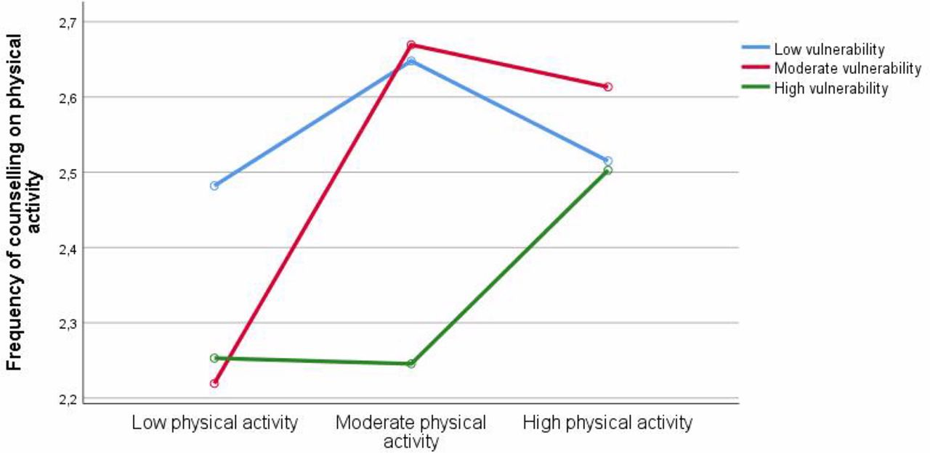

Interaction of vulnerability on own physical activity when counselling on physical activity
Anna Sofia Viktoria Belfrage et al. BJGP Open 2018;2:bjgpopen18X101607
Copyright © The Authors 2018
Notes:
Interaction of vulnerability on own physical activity when counselling on physical activity

